Slide 1

ANNAMACHARYA INSTITUTE OF TECHNOLOGY AND SCIENCES::TIRUPATHI
(AUTONOMOUS)
Computer Science and Engineering
A.Y.: 2022-2023
Age and Gender Detection using Deep Convolutional
Neural Networks
AUTHORS
G LAKSHMI PRIYA
Y KALAVATHI
Y PAVAN KALYAN
P RAJASEKHAR

Slide 2
ABSTRACT
A Human face shows various emotions, expressions, and many more. Here we are going to determine the age of a human person through his/her face. Automatic prediction of age and gender from face images has drawn a lot of attention recently, due it is wide applications in various facial analysis problems.
The age estimation from the face is a challenging problem because of many internal factors, such as gender and age, and external factors, such as environments and lifestyles.
Using attention mechanism enables our model to focus on the important and informative parts of the face, which can help it to make a more accurate prediction. We train our model in a multi-task learning fashion, and augment the feature embedding of the age classifier, with the predicted gender.
In this project, we are going to use Deep Learning to accurately identify the gender and age of a person from the image of a face. The predicted gender may be one of ‘Male’ and ‘female’ and the predicted age is in the range of (0 – 2), (3 – 6), (7 – 12), (13 – 20), (21 – 32), (33 – 43), (44 – 53), (54 – 60) and so on.

Slide 3
INTRODUCTION
Age and gender information are especially important for various real-world applications, such as social understanding, biometrics, identity verification, video surveillance, human computer interaction, electronic customer, crowd behaviour analysis, online advertisement, item recommendation, and many more.
Despite their huge applications, being able to automatically predicting age and gender from face images is an extremely hard problem, due to the various sources of intra-class variations on the facial images of people.
In this work, we propose a deep learning framework to jointly predict the age and gender from face images. We use an attentional convolutional network as one of our backbone models, to better attend to the salient and informative part of the face.
Also, given that knowing the gender of someone, we can better estimate her/his age, we augment the feature of the age-prediction branch with the predicted gender output.

Slide 4
OBJECTIVE
Humans cannot accurately predict the age based on looking at a person however we have an idea of whether they are in their 20's or in their 30’s.
Because of this reason it is wise to frame this problem as a classification problem where we try to estimate the age group the person is in.
The main objective of gender and age detection is to guess the gender and age of the face of an individual in a picture using Deep Learning on the audience dataset.
Moreover, to get the most effective predictions and result by overcoming the problem of accuracy and time.

Slide 5
SYSTEM ANALYSIS
Initially an image is given as input to the system or we must take the input by using system camera. The image is processed by using Convolutional Neural Networks (CNN) in deep learning,
The aim of the convolutional neural network is to split the image features like eyes, nose, chin, cheeks, lips etc. After that, the features are compared with the trained data set i.e., ADIENT DATASET.
Each picture which in trained in dataset are compared with the given input image.

Slide 6
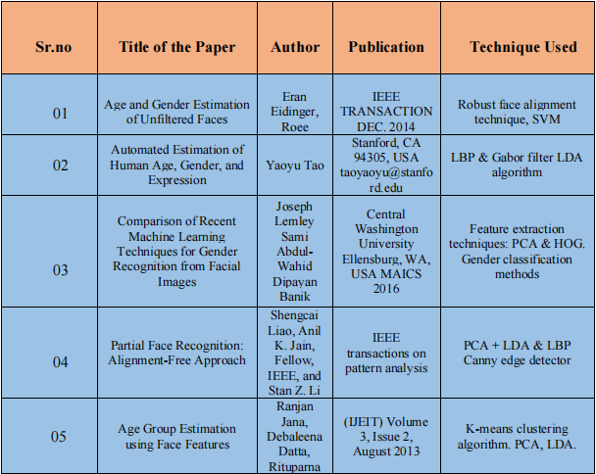
LITERATURE REVIEW

Slide 7
SYSTEM DESIGN
The network architecture used for age approximation in based on the paper of G. Levi and T. Hassner. This network is intended to be shallow to prevent over-fitting. All the three colors i.e., Red, Green, Blue are processed directly.
The images are scaled to 256 x 256 and cropped to 227 x 227. The network consists of 3convolution layers followed by 3 fully connected layers.

Slide 8
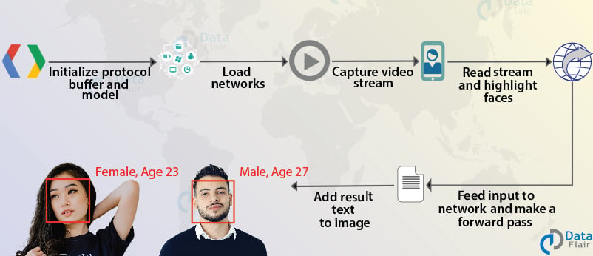
SYSTEM DESIGN
Architecture

Slide 9
AUDIENCE DATA SET DESIGN
Gender | 0 - 3 | 4 - 8 | 9 - 13 | 14 - 20 | 21 - 25 | 26 - 32 | 33 - 40 | 41 - 48 | 48 - 55
Male | 700 | 900 | 900 | 700 | 2300 | 1200 | 1300 | 800 | 700
Female | 700 | 900 | 1200 | 1450 | 2700 | 1500 | 1700 | 800 | 650
Both | 1400 | 1800 | 2100 | 2150 | 5000 | 2700 | 3000 | 1600 | 1350
55 - 62 | 62 - 100 | Total
750 | 450 | 10,700
500 | 400 | 12,500
1250 | 850 | 23,200

Slide 10
CONCLUSION
We investigated two problems of the face processing field, face recognition, and age and gender classification. We reviewed recent developments in these two fields and our survey demonstrated that many of the existing methods suffer from difficulties in analysing data collected from uncontrolled environments. These difficulties stem from the fact that, in face, gender and age recognition problems, proposing a model that allows for an accurate recognition that can be generalized to apply to everyone is not an easy task.

Slide 11
REFERENCES
[1] Vincenzo Carletti, Sai Greco, Gennaro Priyanka Cannella, and Mario Vento, “Age from Faces in the Deep Learning Revolution”, IEEE TRANSACTIONS ON PATTERN ANALYSIS AND MACHINE INTELLIGENCE, VOL. 42, NO. 9, 20 pages, SEPTEMBER 2020.
[2] Y. Sun, M. Zhang, Z. Sun, and T. Tan, “Demographic analysis from biometric data: Achievements, challenges, and new frontiers,” IEEE Trans. Pattern Anal. Mach. Intell., vol. 30, no. 2, pp. 332–351, Feb. 2018.
[3] Y. Fu, G. Guo, and T. S. Huang, “Age synthesis and estimation via faces: A survey,” IEEE Trans. Pattern Anal. Mach. Intell., vol. 32, no. 11, pp. 1955–1976, Nov. 2010.
[4] ARWA S. AL-SHANNAQ AND LAMIAA A. ELREFAEI, “Comprehensive Analysis of the Literature for Age Estimation from Facial Images”, ACCESS.2019.2927825, vol 7, July 2019.

Slide 12
Any Questions?
Thank You

